Slide 1
Goal Programming
Mahfuzul Hoque Ph.D
Professor,
Department of Accounting & Information Systems
Faculty of Business Studies
University of Dhaka
DMH

Slide 2
Introduction
Goal Programming is the mathematical programming model that is formulated in terms of objective function & constraints equations. The objective function represent the goal that the decision maker seeks to achieve & the constraint equations represent restrictions in terms of achieving the targeted goal.

Slide 3
Definition: Goal Programming
A mathematical programming technique that permits decision maker to set & prioritize multiple objective function.

Slide 4
Why goal programming?
In today's business environment profit maximization or cost minimization are not always the only objective that a firm sets forth. Organizations faces a more complex situation due to tough competition, social responsibilities, satisfying customers, diversified product lines & many more. Now a days along with profit maximization or cost minimization, Organizations need to consider the market share to gain, maintaining full employment, providing quality ecological management & like.
To attain simultaneous goals it is necessary to analyze each alternative in light of its potential impact on several goals (or criteria). Multiple goals are only considered under goal programming.

Slide 5
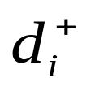
Deviations
Deviations are the amounts by which goals are either over achieved or underachieved.
Example: Company X has following three goals
1. Achieve a profit of at least tk300,000 per month.
2. Do not exceed 500 hours of overtime per month.
3. Maintain an inventory level of exactly 20 units.
The overachievement deviations measure the extent to which the goals are exceeded; they are labeled by the deviational variable

Slide 6
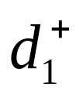
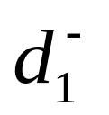
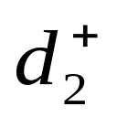

If the Profit is tk320,000,then
= 320,000 -300,000 = 20,000; = 0
If overtime is 550 hours, then
= 550 – 500 = 50; = 0
Though overachievement second one is not desirable.

Slide 7
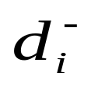
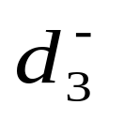
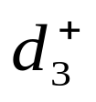
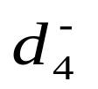

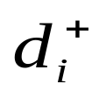
The underachievement deviation measure the extent by which performance is less than the goal. They are denoted as .
If profit level is tk290,000, then
= 300,000 – 290,000 = 10,000; = 0
If overtime is 460 hours, then
= 500 – 460 = 40; = 0
Both & must be non negative & at least one of them must be zero.

Slide 8
Ranking goals
In goal programming problems, goals are prioritized or ranked according to there relative importance to the organization. Lower- order goal are considered only after higher-order goals are met. Goals may be ranked in three different ways:
Ordinal ranking: Goals are listed in order of there importance.P1 designates the priority level of the most important goal,P2 the second most important goal, & so on.
Cardinal ranking: A specific weight is assigned to each of the deviation, showing the relative importance of each deviation.
A mixture of the above two can also be used.

Slide 9
Problem Formulation & Graphical Presentation
The Structure of Goal Programming (GP)
The GP model is composed of four elements:
Decision variables.
System constrains.
Goal constrains.
Objective function.

Slide 10
1. Decision Variables
The variable whose values are unknown & search
for .Usually they are designated by x, y.
2. System constrains
System constrains are identical to LP constrains.
They represent absolute restrictions & do not allow
any deviations.
For Example: It is impossible to work more than 21 shifts (7*3) each week.

Slide 11
3. Goal Constrains
Goal Constrains represent target values to be achieved.
Example 1:
Assume that the decision variables are the products to include in a product mix. Product A brings a tk5 profit contribution, product B nets a tk7 profit contribution, & product c brings a tk3 profit contribution. The total profit is:
5A + 7B + 3C
In regular LP, we attempt to maximize this function. In GP we first write it as:
5A + 7B + 3C > 200,000

Slide 12
Where 200,000 is a desired profit level. However, because
we allow deviations, the constraint is written instead as:
5
A
+
7
B
+
3
C
+
d
-
-
d
+
=
200,000
(Target)
1
1
But in LP this goal constraints treated as objective function & we want to maximize this function. This function is written in LP as Maximize profit = 5A + 7B +3C (Single goal) .
As in goal programming we are not dealing with single objective but with different objectives or goals & for satisfying those goals there may arise some deviations (positive or negative). For this reason our objective is not to maximize a particular goal but to minimize the different unfavorable deviations.

Slide 13
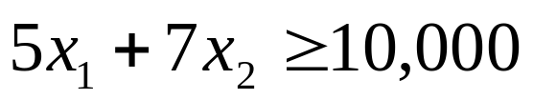
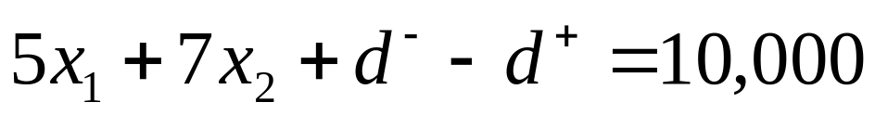
The Signs in Front of the Deviations
Here to notice that a d⁺ deviation is always preceded by a minus sigh, while a d⁻ deviation is always preceded by plus sign. The reason for this is shown in the following example. Assume we have a profit constrains:
In GP terms, we change it to:

Slide 14
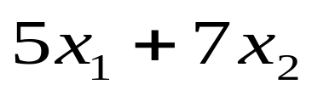
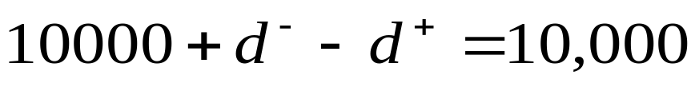
Three cases may occur in the solution:
1. The profit will be exactly 10,000. In such a cases, both d⁻ & d⁺ must equal to zero. Replacing the value of the function we find:
As the goal is satisfy at our desired level the ‘–’ or ‘+’ sign don’t creates any problem. But the real life is not so much easy that we can achieve what we want.

Slide 15


2. The profit will be less than 10,000 (underachievement), say, 9,000.
This problem is related with underachievement of goal.
Underachievement is symbolized by “d⁻” . Here we have to careful about the non negativity assumption I.e. deviations cannot be negative. So when we form the goal constrains we have to consider these two conditions. By considering these two conditions we form the goal constrain like the following:
we get the following solution: d⁻= 1,000, d⁺ = 0.

Slide 16



But if we reverse the sign then the equation is like the following
Now there are two variables & we in dilemma that what are the value of d⁻ & d⁺. The solution is not complex, if we apply the first condition i,e, underachievement which is represented by d-, the solution is – d- = 1,000. But it is not possible because there is the second condition i,e,. nonnegativity assumption. Therefore, to come out of this situation we must use d- preceded by “+”sign & d+. with “-”sign.

Slide 17

3. The profit is larger than10,000; say 12,000. Solving the equation, we get: d⁺ = 2000, d⁻ = 0
4. Objective function
The objective function in GP is formulated to minimize the weighted sum of the undesirable deviations. Therefore the structure of such function dependents on the weighting system. The following variations exist:
A. Single Objective Problem
In such case, the objective function is : minimize
(Over achievement may be harmful for organization, i,e, taxable income or over utilization of working hours)

Slide 18
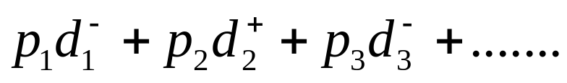
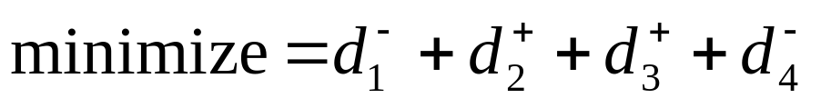
B. Multiple Objectives, Ordinal Ranking
The objective function is written as:
Minimize z =
Where the P_{i} indicates the importance of the goal.
C. Multiple Goals that are Equally Important
If all goals are equally important, then the objective is simply to minimize the sum of the undesirable deviations. For example:

Slide 19
  D. Multiple Goals, Use of a Cardinal Scale
In this case, a specific weight is assigned to each undesirable deviation. This approach is especially important when the dimension of deviation are different. An objective function in such a case may look like this:

Slide 20
E. Multiple goals, Use of Cardinal & Ordinal Scales
This is an extension of the ordinal scale for a case where there two undesirable deviation for one goal. Let us assume that this happened in the third goal. In such case, weights are assigned to determine which deviation is more important within the same priority level. The objective function is such a case will look like this:
That is, the negative deviation of the third goal is 3/2 = 1.5 times as important as the positive one.

Slide 21
Problem Formulation & Graphical
Solution: Hilliard Electric Company
The Hilliard Electric, produces specially coded computer chips for laser surgery in 64MB & 256MB. Both the computer chips require a two step production process involving wire & assembly. It takes about 2 hours to wire each 64MB chip & 3 hours to wire a 256MB chip. Final assembly of the 64MB & 256MB chips require 6 & 5 hours respectively. The production capacity is such that only 12 hours of wiring & 30 hours of assembly time are available. Net profit for each 64MB chip $7 & each 256MB chip $6.

Slide 22
Lets now look at the situation in which Hilliard's management want to achieve several goals
Goal 1: to produce as much profit above $30 as possible during the production period.
Goal 2: to fully utilize the available wiring department hours.
Goal 3: to avoid overtime in the assembly department.
Goal 4: to meet a contract requirement to product at least seven 256MB chips.

Slide 23
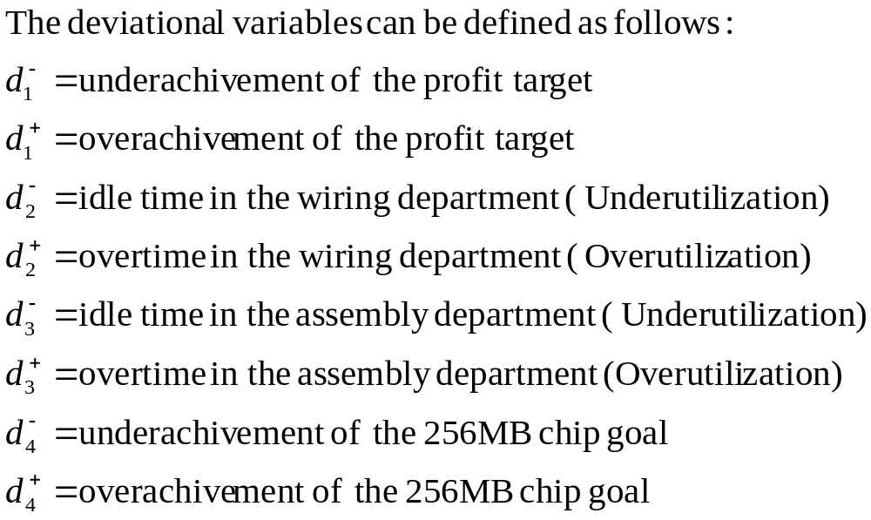

Slide 24
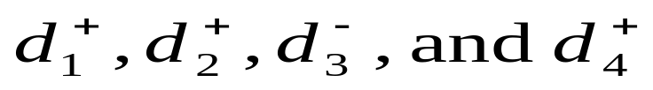
Management Concern:
Management is unconcerned about whether there is overachievement of the profit goal, overtime in the wiring department, idle time of in the assembly department, or more than seven 256MB chips are produced; hence,
may omitted from the objective function.

Slide 25
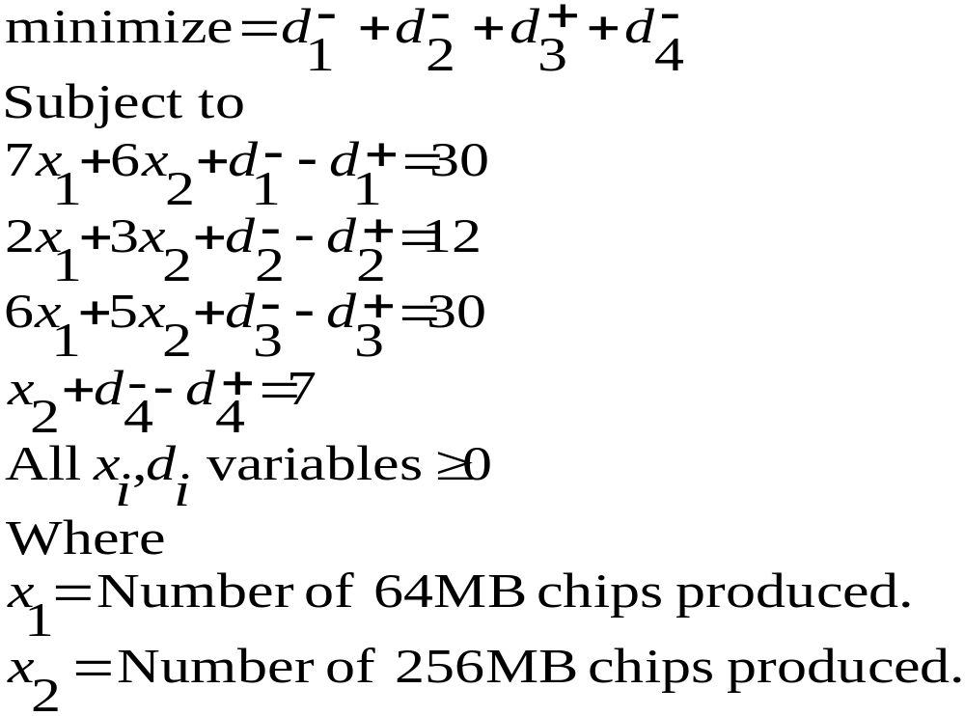
If we don’t consider the ranking of the goal i.e. all goals are equally important then the objective function & constrains are:

Slide 26
Ranking of Goals:
Let’s say Hilliard Electric sets the priorities shown in the following:
Goal
Priority
Reach a profit as much as much above $30 as possible
P1
Fully use of wiring department hours available
P2
Avoid assembly department overtime
P3
Produce at least seven 256MB chips
P4

Slide 27
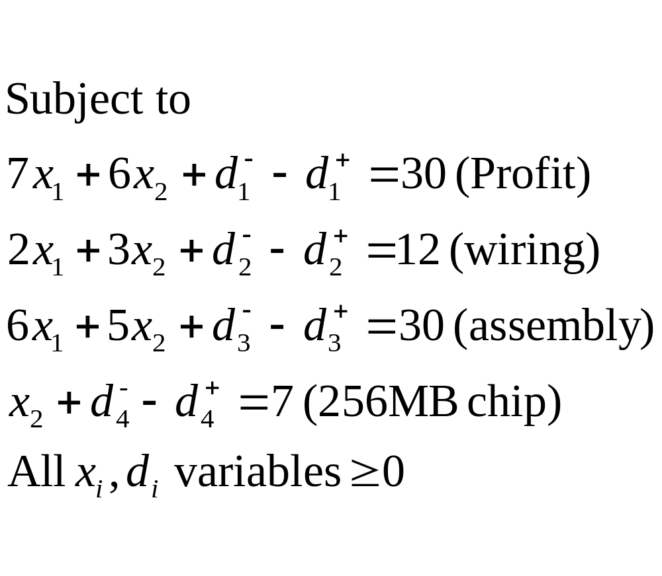
If we consider the priority of meeting the goal then the new objective function becomes

Slide 28
Solving Goal Programming Problem Graphically
Before solve the problem graphically we must aware of three characteristics of goal programming problems
1. Goal programming models are all minimization problems.
2. There is no single objective but multiple goals to be attained
3. The deviation from a high priority goal must be minimize to the greatest extent possible before the next highest priority goal is considered

Slide 29
Targeted goals:
Goal 1: to produce as much profit above $30 as possible during the production period.
Goal 2: to fully utilize the available wiring department hours.
Goal 3: to avoid overtime in the assembly department.
Goal 4: to meet a contract requirement to product at least seven 256MB chips.

Slide 30
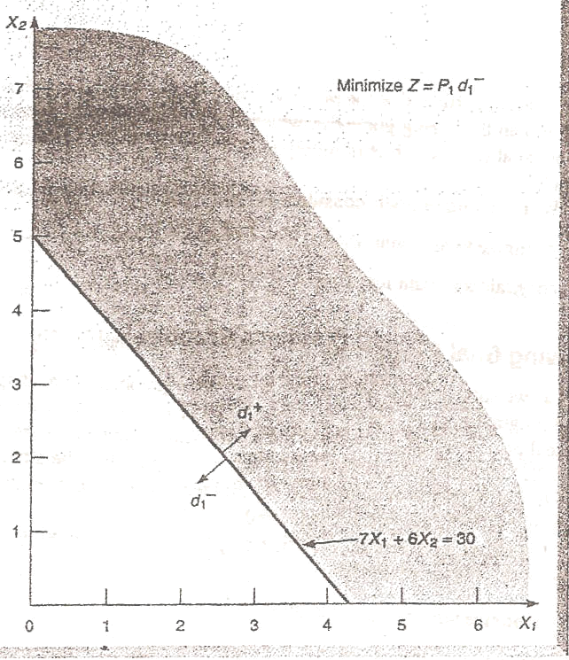
Figure 1:Analysis of First goal

Slide 31
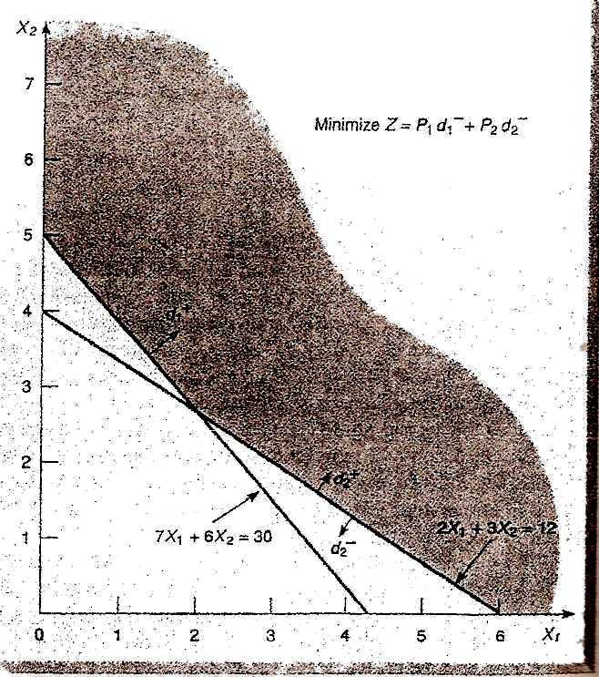
Figure 2: Analysis of First & Second Goal

Slide 32
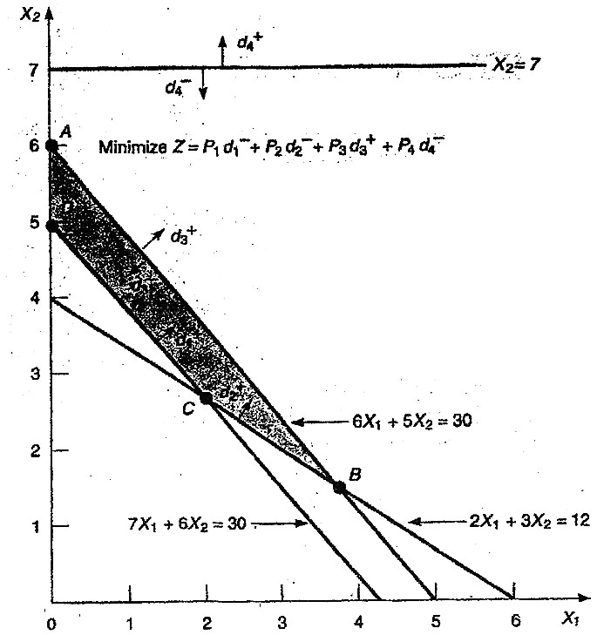
Figure 3: Analysis of All Four Priority Goals

Slide 33
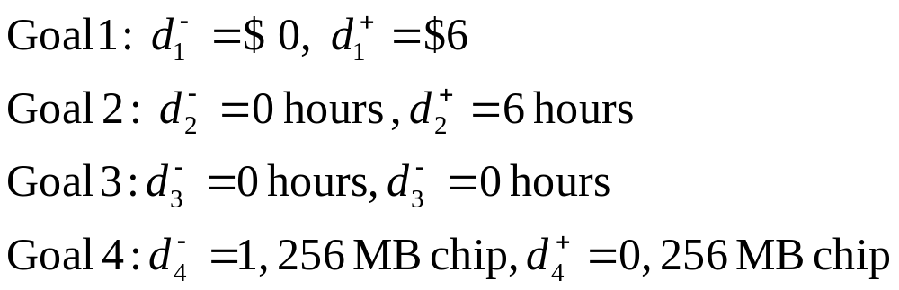
Optimum Solution
The solution is found at corner point A, which satisfies the first three goals & comes to c lose to achieving the fourth goal. We easily see that its coordinates are X1 = 0 & X2 = 6
Substituting these values into the goal constrains, we find that other variable are
Thus the profit goal was met & exceeded by $6, the wiring department was fully utilize as 6 hours of overtime were used there, the assembly department had no idle time or overtime, & the 256MB chips goal was underachieved by only one fan. This was the most satisfactory solution of the problem.

